Slide 1
Docker Compose

Slide 2
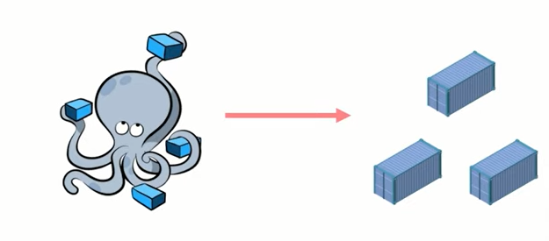
Docker Compose
For Now, let’s just understand that Docker Compose is just a Service within Docker that let’s us launch multiple containers at the same time.

Slide 3
How to install Docker Compose
Yes, we need to install Docker compose separately this is not preinstalled service with Docker.
Commands to install Docker Compose:
~ sudo curl -L "https://github.com/docker/compose/releases/download/v2.11.2/docker-compose-
$(uname -s)-$(uname -m)" -o /usr/local/bin/docker-compose
~ sudo chmod +x /usr/local/bin/docker-compose
~ docker-compose --version

Slide 4
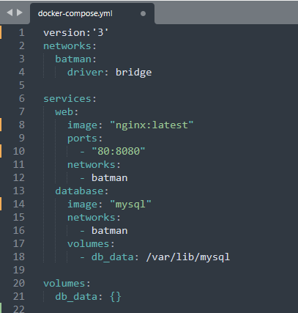
Docker Compose Example
~ sudo docker-compose up
~ sudo docker-compose down
~ sudo docker-compose ps
~ sudo docker-compose run db env
~ sudo docker-compose stop

Slide 5
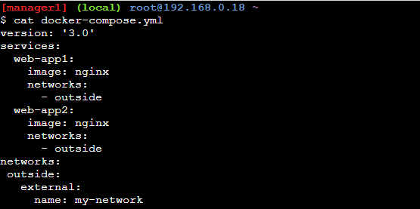
Docker Compose Example
If want to use existing network
In docker compose use external.

Slide 6
Thank You !

